Slide 1
Requirements Engineering Practices in the Context of Explainable AI:
A User Evaluation Study

Slide 2
Conducted by
Umm-e- Habiba (TU München) | umme.habiba@tum.de
Lucas Mauser (Daimler Truck) | lucas.mauser@daimlertruck.com
Dr. Jonas Fritzsch (University of Stuttgart) | jonas.fritzsch@iste.uni-stuttgart.de
Dr. Justus Bogner (Vrije Universiteit Amsterdam) | j.bogner@vu.nl
Prof. Dr. Stefan Wagner (TU München) | stefan.wagner@tum.de

Slide 3








Why Explainable AI (XAI)?
Making AI systems more understandable to humans
< / >
Not a technical requirement but a multifaceted concept
The cornerstone for building user trust, enhancing system transparency, and fulfilling legal requirements

Slide 4
Who are Key Stakeholder?
Who? Regulatory entities/agencies
Why? Certify model compliance with the legislation in force, audits,…
Who? Users affected by model decisions
Why? Understand their situation, verify fair decisions…
Who? Data scientists, developers, product owners…
Why? Ensure/improve product efficiency. Research. New functionalities…

Slide 5
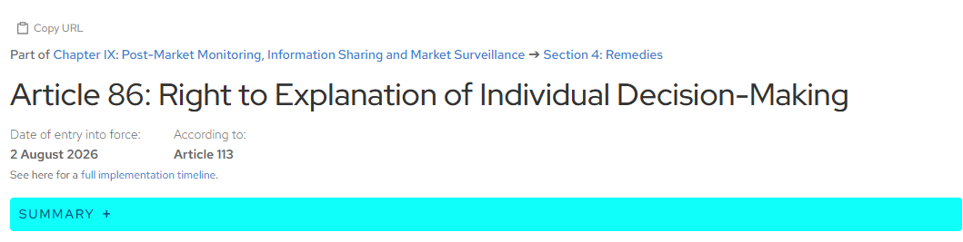
EU-AI Act
Notes:
https://artificialintelligenceact.eu/article/86/

Slide 6
Example
AI in Medical Diagnosis and Treatment
Regulation Context: AI-based medical diagnostics and treatment decision support systems are categorized as high-risk. These systems must ensure transparency and explainability to both healthcare professionals and patients.
Explainability Requirement: The system must provide healthcare professionals with a detailed explanation of how the diagnosis was reached or why a specific treatment was recommended.
Example: An AI tool recommending cancer treatment must clearly indicate the medical data it analyzed and how it reached its conclusion.

Slide 7
Interview with Legal Experts (Findings)
If you are caught by the policymakers and the regulators, and this could be because they find your company and your practices or because someone complained about it, right, such as a user, then the fine that you can get could reach 10% of the global turnover of your company.
So even if you are a small company within the large group, you would take 10% of the large group annual turnover, and the fine could reach 10% of that, which could be a lot.

Slide 8
Interview with Legal Experts (Findings)
When the court imposed that Microsoft should publish that technical documentation, the company started with two employees and tasked those employees to generate the technical documentation in about a couple days. It actually took the company over ten years and 800 employees working full time on generating the technical documentation because they didn't have it and it appears to be much more complex than what they anticipated. Now this is just a technical documentation for a non AI system, so allegedly much easier to produce than the one if you are running an unsupervised machine learning, AI system. And on top of that, the act says that you should explain, as I already mentioned, how that's technical documentation is in line with EU fundamental rights.

Slide 9
Motivation
Based on our previous work^{[1][3][5]} we found that there is a lack of the adoption of Requirements Engineering for addressing explainability requirements for AI-based system
This research addresses critical questions on the practicality of elicitation, specification, and validation practices, ultimately identifying gaps and areas for improvement in the field of explainable AI
Notes:
Habiba, Umm-E., Justus Bogner, and Stefan Wagner. "Can requirements engineering support explainable artificial intelligence? Towards a user-centric approach for explainability requirements." 2022 IEEE 30th international requirements engineering conference workshops (REW). IEEE, 2022.
Habiba, Umm-E., et al. "How do ML practitioners perceive explainability? an interview study of practices and challenges." Empirical Software Engineering 30.1 (2025): 18.
Habiba, Umm-E., et al. "How mature is requirements engineering for AI-based systems? A systematic mapping study on practices, challenges, and future research directions." Requirements Engineering (2024): 1-34.

Slide 10
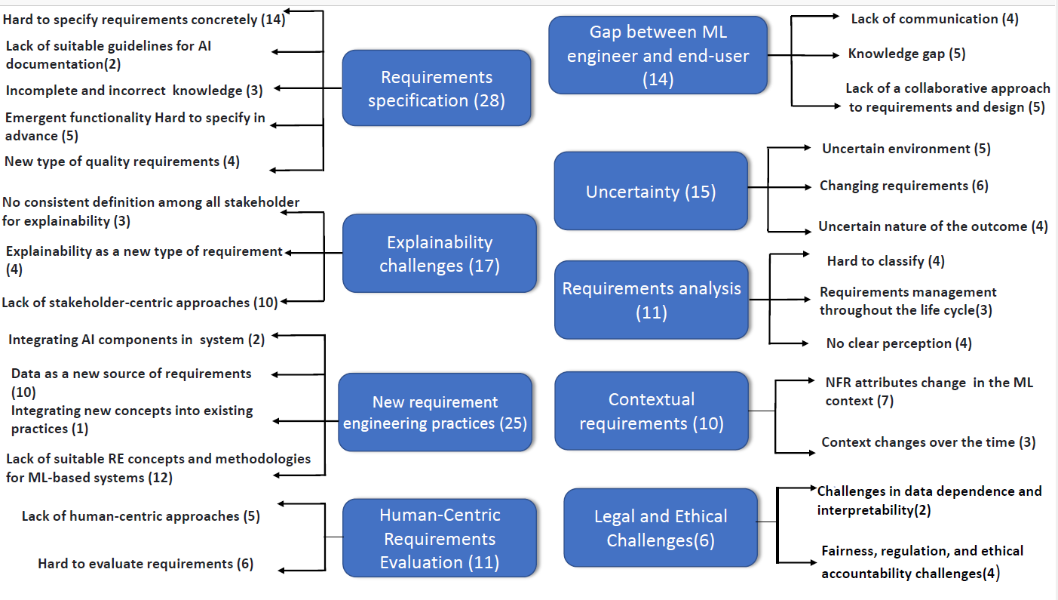
Explainability challenges found in litertature

Slide 11
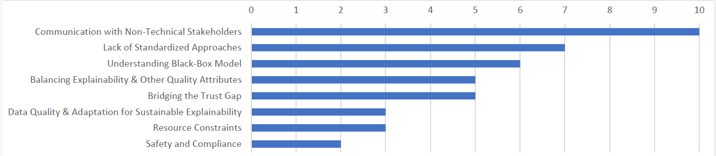
Explainability challenges as mentioned by practitioners

Slide 12
Why XAI? --> Why is it important for a company as DTAG?
Explainable AI (XAI) goes beyond merely building accurate AI models. It emphasizes transparency, interpretability, and trust. For a large commercial vehicle manufacturer like Daimler Truck Holding AG (DTAG), adopting XAI can yield significant benefits across safety-critical AI-based systems, customer trust, and regulatory compliance.
Aligning With Regulatory and Legal Imperatives
  A regulatory imperative is based on rules set by specific regulatory agencies for a particular sector, while a legal imperative is based on formal laws passed by the government.
Notes:
A robust RE process ensures all explainability requirements are captured and directly traceable to regulatory standards—avoiding costly rework or liability issues later.
Properly documented requirements facilitate internal investigations and external compliance checks—reducing legal exposure and strengthening claims of due diligence.

Slide 13
Why is it important for a company?
Rapidly Evolving Regulations
  Autonomous vehicles are heavily inspected: Manufacturers must demonstrate how AI systems make decisions in regions such as the EU (EU AI Act) and the US (NHTSA guidelines).
Legal Risk Mitigation
  In the event of an incident (e.g., collision, malfunction), DTAG will need a clear audit trail showing it proactively defined and tested explainability features.
Notes:
https://www.nhtsa.gov/laws-regulations

Slide 14
Why is it important for a company?
Improving Stakeholder Trust and Brand Reputation
  Transparent Decision-Making
    Commercial fleets, logistics partners, and end customers want explanations of why an AV behaves as it does—especially for safety-critical decisions like braking or steering.
  Market Differentiation
    With multiple automotive and trucking OEMs racing to offer autonomous solutions, XAI (Explainable AI) can be a distinctive selling point.
Notes:
A structured RE approach formalizes how explainability is implemented, guaranteeing consistent clarity across the fleet.
Demonstrating that DTAG systematically builds in transparency, rather than bolting it on, bolsters the company’s reputation for safety and innovation.

Slide 15
Why is it important for a company?
Boosting Internal Efficiency and Product Quality
  Systematic Development
    Ad hoc addition of XAI features often leads to incomplete or inconsistent explanations. Proper RE guidelines ensure no crucial stakeholder need is overlooked, reducing future rework.
  Faster Debugging and Maintenance
    Explanations aren’t just for end-users—internal teams use them to pinpoint system flaws.
Notes:
Traceable requirements also help avoid confusion or duplication across inter-disciplinary teams (software engineers, data scientists, domain experts).
Requirements that specify how explanations should look (e.g., feature attributions, rule-based outputs) make debugging quicker and more reliable.

Slide 16
Problem Statement
Current approaches and studies have shed light on various aspects of explainability requirements.
However, these approaches often address specific aspects of explainability and lack a comprehensive method to satisfy end-users demands by validating these requirements.
Notes:
Research and development efforts
are required to provide more comprehensive and user-focused
solutions for capturing and satisfying explainability require-
ments. Thus, we aim to provide a reference process model
for improving the incorporation of explainability requirements
into the RE process to build trustworthy and effective AI-based
systems.

Slide 17
What do we want to achieve?
Experimenting with experts, we aim to understand current practices and challenges better.
User Evaluation Study
Practices
Challenges

Slide 18
Welcome to the Study Session
Thank you for participating!
Today’s Goal:
  Learn and apply Requirements Engineering (RE) practices
  Collaborate, explore, and reflect together Focus on Explainability Requirements in AI-based systems

Slide 19
Use Case Overview – ASGA
Assists drivers in detecting blind spot objects
Key Scenarios:
  Obstacle detection
  Alerts & system responses
  Situations needing clear explanations

Slide 20
How This Study is Structured
Total participants: 9
3 Phases:
  Elicitation → Specification → Validation
You’ll be grouped into teams of 3 (shuffled after each phase)
Each group gets one RE technique per phase

Slide 21
What You’ll Be Doing
Phase 1: Eliciting Requirements
  Interviews, brainstorming, task analysis
Phase 2: Specifying Requirements
  Natural language, use case modeling, softgoal diagrams
Phase 3: Validating Requirements
  Feedback sessions, walkthroughs, compliance check

Slide 22
Speak Your Thoughts Aloud
Talk through your reasoning while performing tasks
Helps us understand your thought process
Use sheets if verbalizing is hard — that’s okay!

Slide 23
Phase 1 – Requirements Elicitation
Assigned one of:
  Interviews
  Brainstorming
  Task Analysis
Use templates & follow steps in your guide
Focus: What should ASGA explain? Why? To whom?

Slide 24
Phase 2 – Specification (Turning Ideas into Requirements)
Assigned one of:
  Structured Natural Language
  Use Case Modeling
  Softgoal Diagrams
Use collected requirements from Phase 1
Your goal: Specify clearly, concisely, and meaningfully

Slide 25
Phase 3 – Validation (Are the Requirements Good Enough?)
Assigned one of:
  User Feedback Session
  Walkthrough
  Compliance Check
Assess quality, clarity, and completeness
Give constructive feedback

Slide 26
Before We Begin
Fill in the Participant Demographic Sheet
Anonymity & confidentiality ensured
Your insights will guide real research!
Ask questions, share thoughts, and enjoy the process
Your input = valuable contribution to better AI systems!

Slide 27
Thank you
Questions?

